Slide 1
Delivering and managing applications at the edge at scale
www.sunlight.io

Slide 2
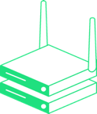
Sunlight is the complete platform for the Lenovo Digital Marketplace
Centralized edge management
Supports 100s to 1000s of nodes
Cloud, hosted, or on-prem
Ansible Application Automation
Industry standard for application packaging
Deploy and update applications and supporting infrastructure with a single click
Application Storefront / Marketplace (Sunlight AppLibrary)
Central library for Ansible Playbook Packages
Public and private library of ISV and custom applications
High Availability
Two or more nodes for failover protection
Autonomous operation where network connectivity is limited
Built for Lenovo, but compatible with industry standard platforms
Factory installation supported on any Lenovo Modular Edge system
Supports ThinkEdge SE70 (Arm and NVIDIA Jetson)
Supports Windows, Linux and Container Platforms

Slide 3
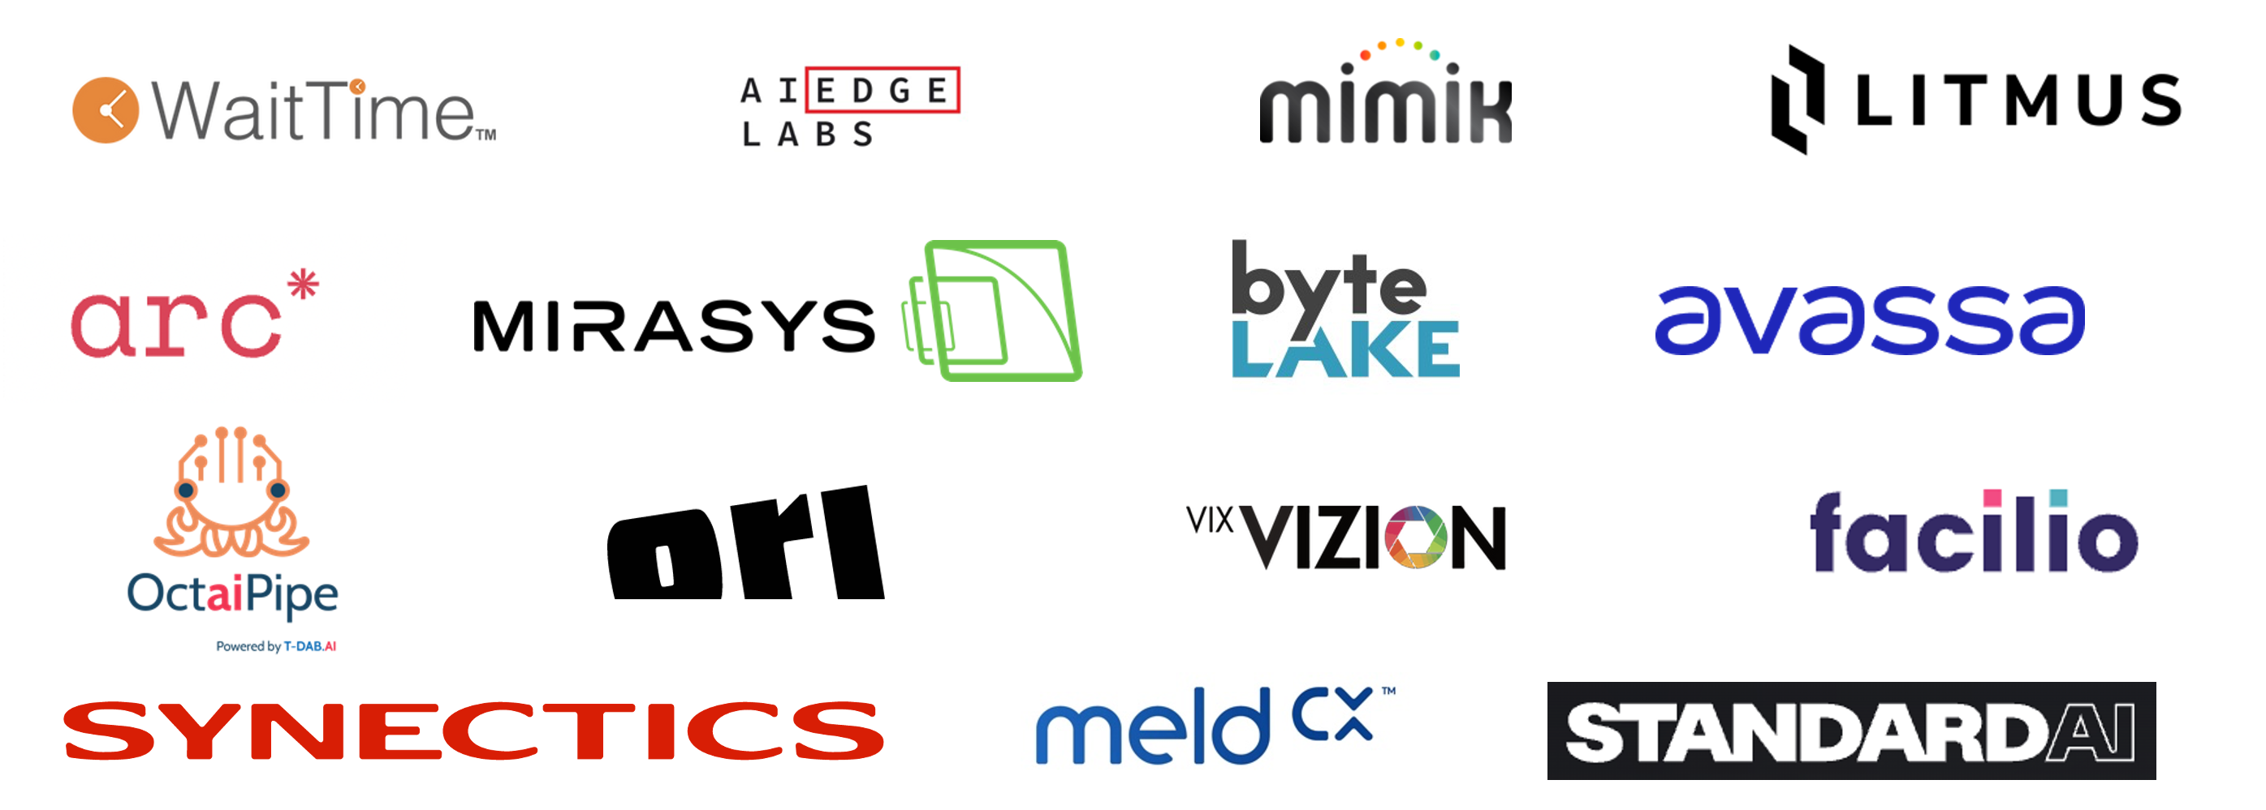
Standardize ISV onboarding with Sunlight
Value for ISVs
Standardized onboarding for all ISV applications
Sunlight abstracts applications from the hardware
Onboard once and deploy across any Lenovo Modular Edge system
Supports any OS or container platform
Instantly scale across 1000s of edge nodes
Highly available infrastructure with two or more nodes
End-to-end delivery to site via factory installation - just apply power and connectivity
1-click delivery of applications to the edge
$

Slide 4
The Sunlight Onboarding Program for ISVs
1
2
3
ISV provides details about the infrastructure environment and installation steps to the Sunlight solutions team
Sunlight solutions team creates an automated playbook and an entry in the AppLibrary
Sunlight publishes the app on the channel and end-users get access
How do end customers purchase app licenses?
ISV application license procured through Lenovo VLS
Apps can be public or private, depending on the vendor requirements and licensing framework
Secure vault is provided for license key distribution

Slide 5
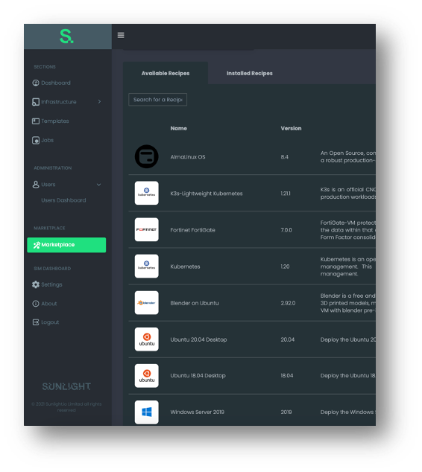
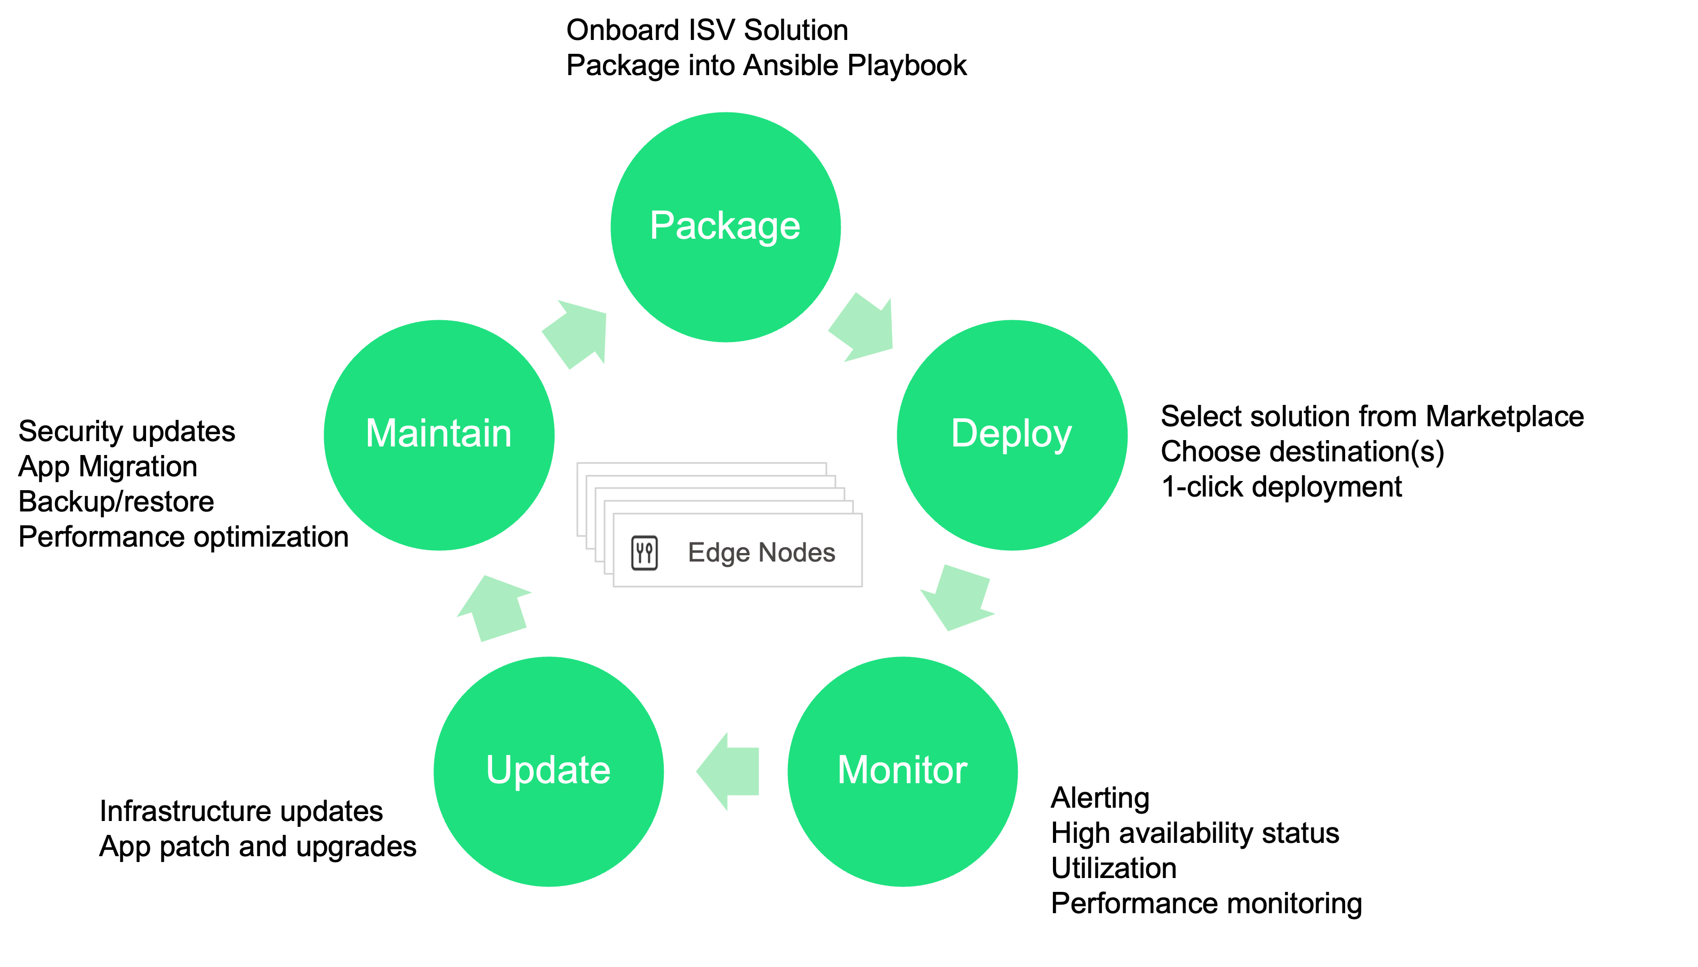
Complete application lifecycle management via the marketplace
Application Marketplace
AppLibrary

Slide 6
Sunlight is the strategic enablement platform for edge go-to-market in the UKI
Application Marketplace Deliver a Lenovo branded application marketplace/storefront for customers
ISV Onboarding Program Onboard all ISV applications with a unified platform
Unified Hardware Support
Certify applications once and deploy across all Lenovo modular edge hardware

Slide 7
www.sunlight.io

