Slide 1
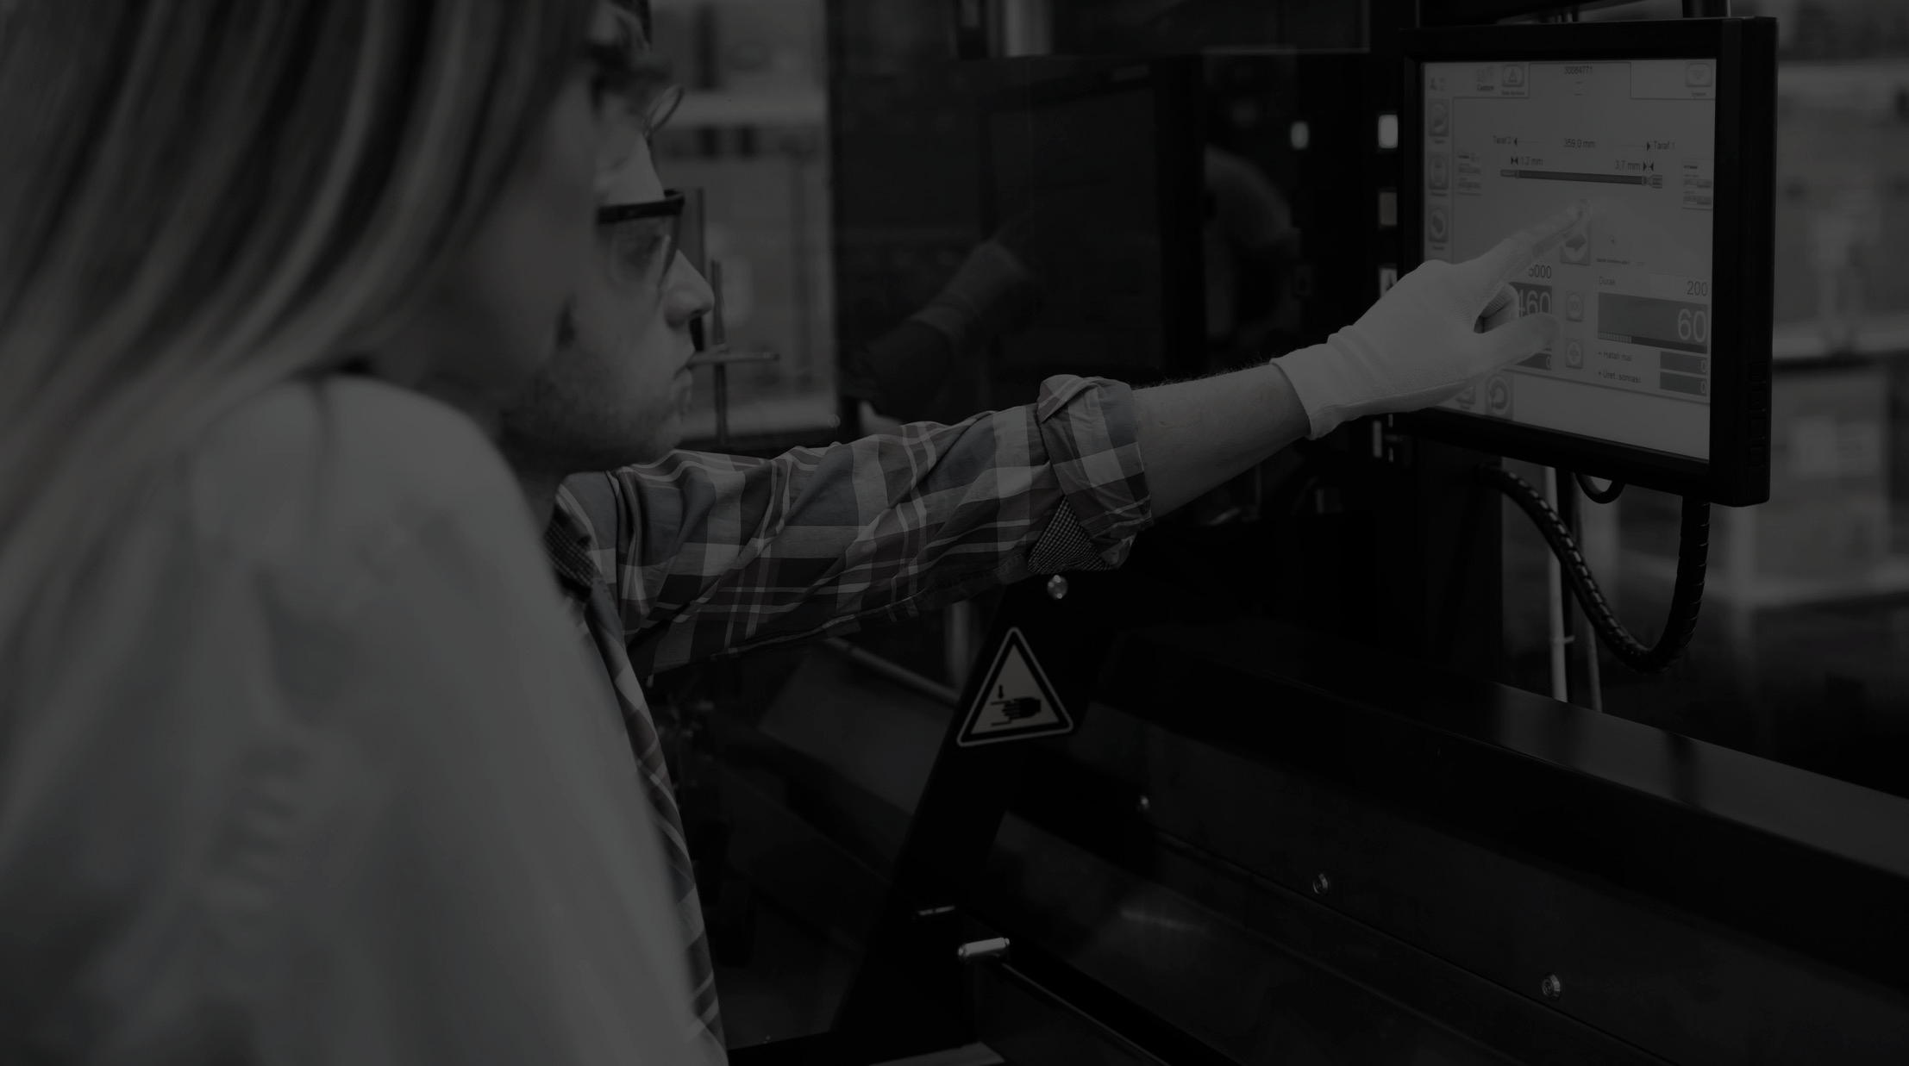

One Edge Platform for all your maritime applications
Proprietary and Confidential - Please do not distribute

Slide 2
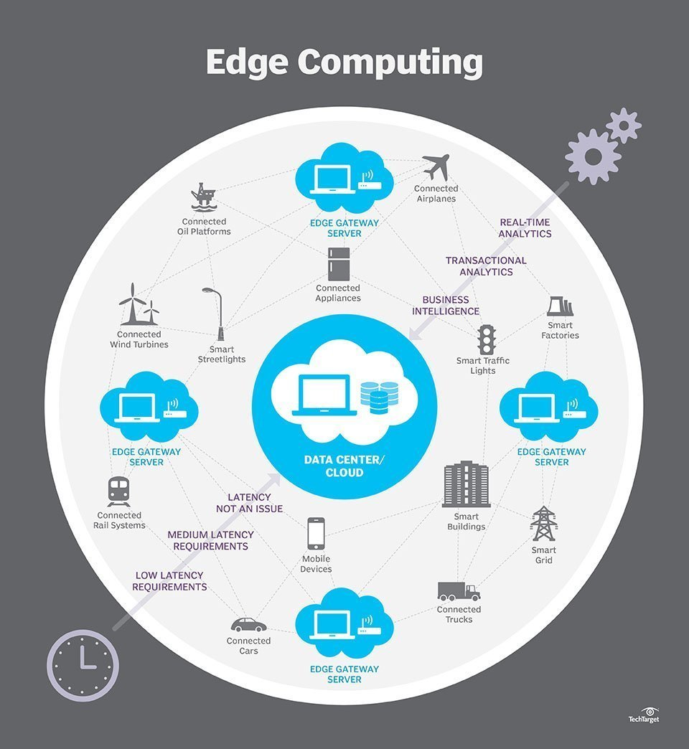

What is The Edge?
The Edge is any place where data is created outside of the datacenter or cloud
The Edge can be a retail store, a hospital, an oil platform, a manufacturing facility, a restaurant, a vehicle, etc.
Edge Computing moves the processing of data closer to where it is being generated leading to significant benefits including:
  Lowering costs
  Improving performance
  Higher availability of applications
  Enabling businesses to benefit from data in real-time
Source: TechTarget “What is edge computing? Everything you need to know.”

Slide 3
Next leap for infrastructure platforms: HyperConverged Edge
Virtualization of datacenters
Hyperconvergence
Edge-to-core
2000
2010
2020
Hardware is expensive
Strategy: consolidate
Operations are expensive
Strategy: scale-out
Moving data is expensive
Strategy: process in-situ
Majority of data generated here
Location
Location
Location
Location
Location
Location
Location
Location
Location
Core Datacenter
Core Datacenter
Core Datacenter
Majority of data generated here
Majority of data generated here
HyperVisor
HyperConverged
Infrastructure
HyperConverged
Edge

Slide 4
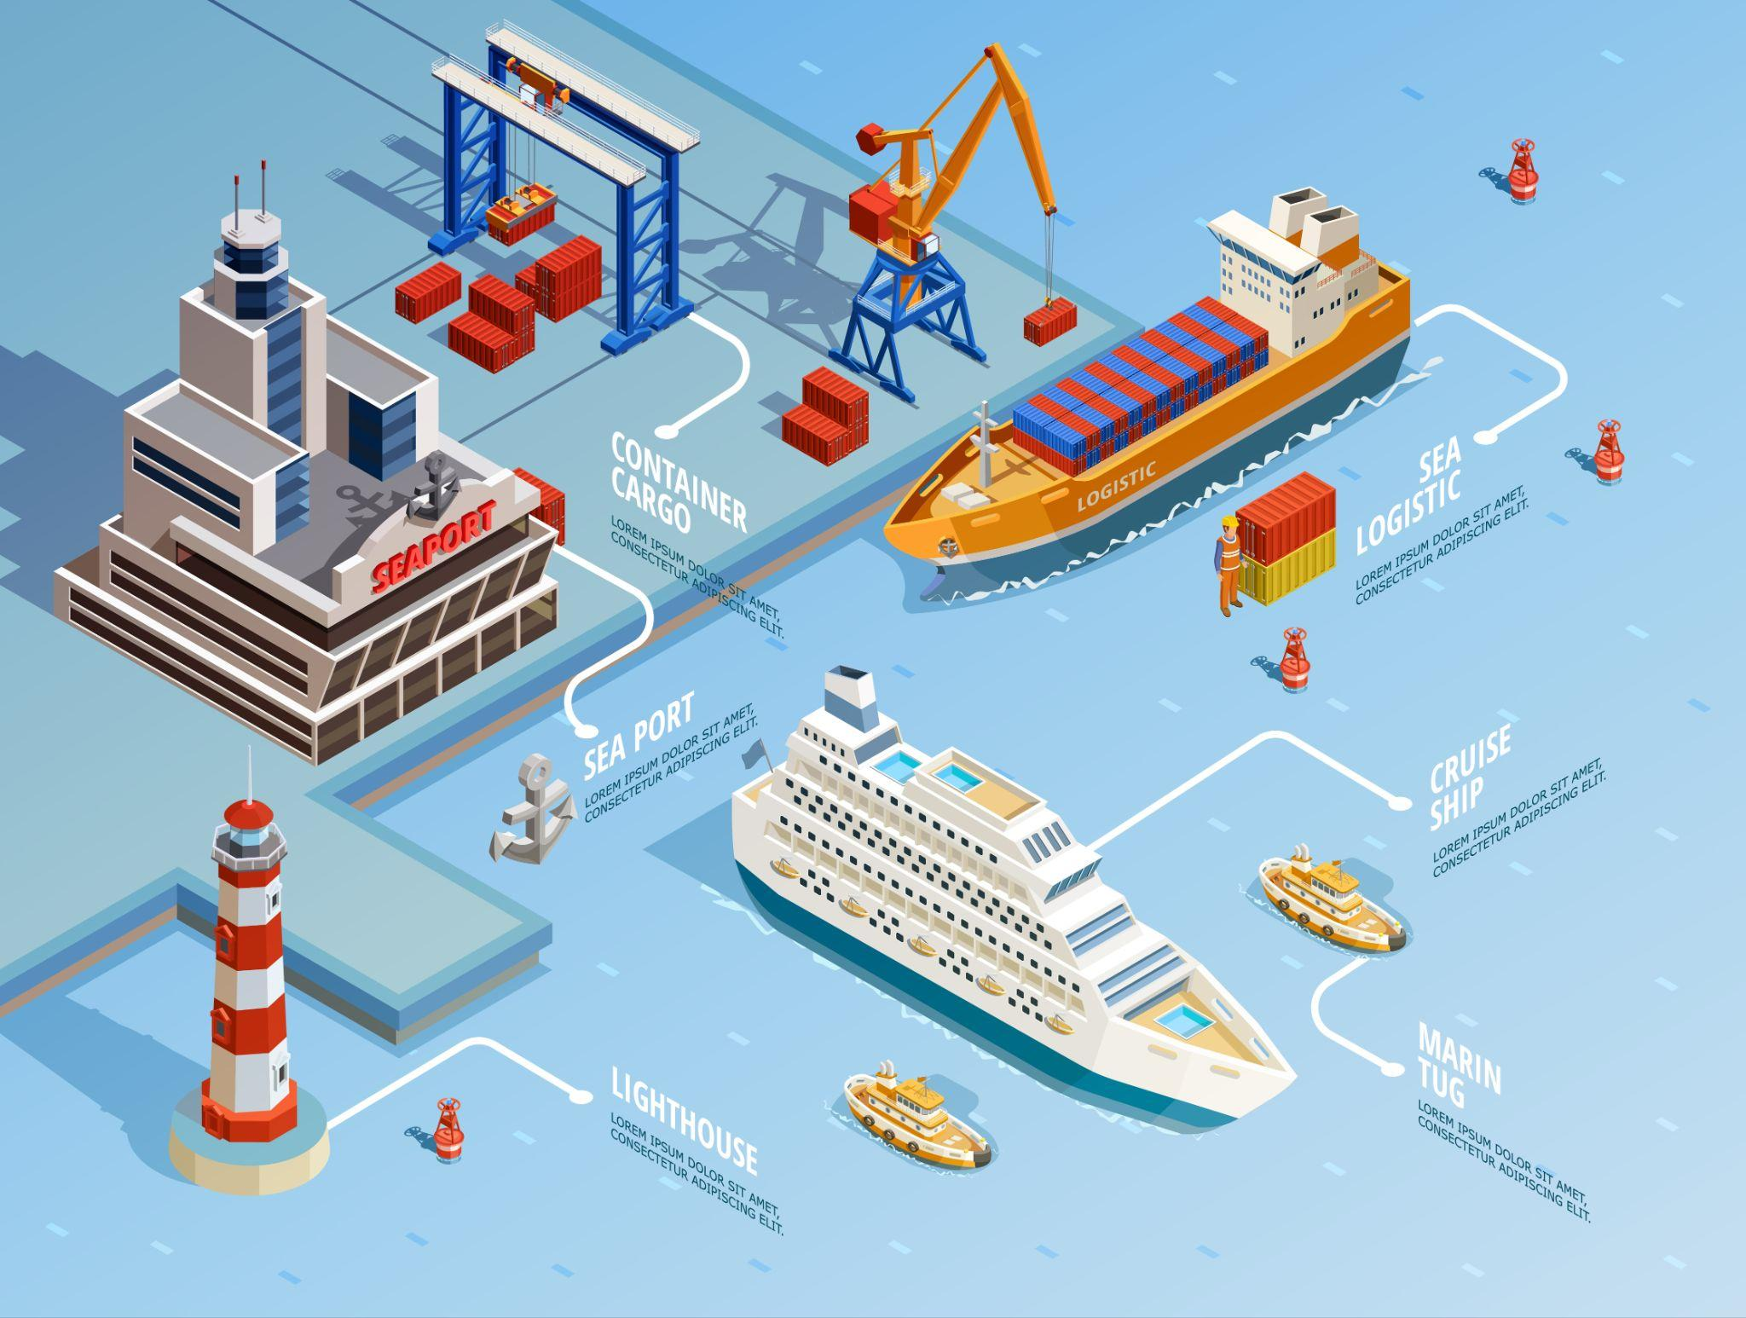
Smart applications are revolutionising maritime
Smart Signage
Health & Safety
Kitchen automation
Stock management
Smart Kiosks
Robotics
Entertainment systems
Satellite communication systems
Table occupancy
and dwell
Navigation
Notes:
The world is changing, advances in technology are changing all aspects of the way we live and where we create data. Applications such as Data Analytics, the Internet of Things, Artificial Intelligence, Machine Learning and Smart Cities are changing the world around us — whether its health and we’re mapping the human genome or in retail with self-service store check outs. We all know about remote working, working from home, maybe it’s agriculture, maintaining crop yields, or in industry monitoring remote oil rigs and creating factory automation. All of this is changing how we live and this is only accelerating.

Slide 5






There is explosive growth in data at The Edge
Edge market drivers
Video, Sensors, Actuators
Edge Server Hardware Mainstream
More Efficient Processors
AI/ML & Analytics Maturity
5G
AI/ML | IOT | Automation | Data Intelligence
Digital transformation has led to growth of applications
Edge Computing helps make businesses proactive and adaptive
Artificial Intelligence, IoT, Automation and Data Intelligence are driving an explosion of data at the Edge
75%▲by 2025
enterprise data generated outside the data center

Slide 6
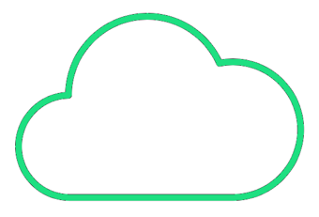
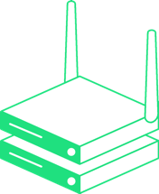







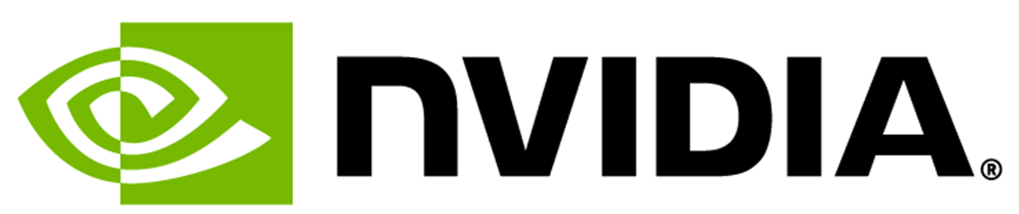
Sunlight is the complete solution for the Edge
The only Hyper Converged stack built for Edge Hardware
Fault-tolerant Micro-cluster deployed at the edge
Tolerate to hardware failures, apps keep running
No onsite technical staff required
Centrally manage 1000s of edge clouds from a single dashboard
Push applications out to the micro-cloud edge sites
Update/security patch/monitor remote applications
The only HyperConverged Edge platform supporting NVIDIA Jetson (e.g. Lenovo ThinkEdge SE70) for deploying optimised computer vision apps at the edge
Highest performance
1M+ Storage IOPs per Node
Multi-Architecture
Runs on x86 and Arm
Smallest footprint
80+% more CPU and RAM efficient than DataCenter HCI

Slide 7
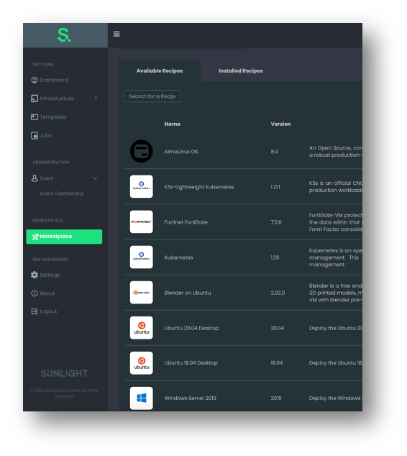
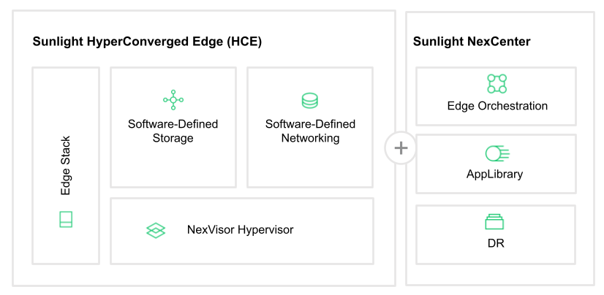
A complete software-defined infrastructure platform
APP LIBRARY
AppLibrary

Slide 8

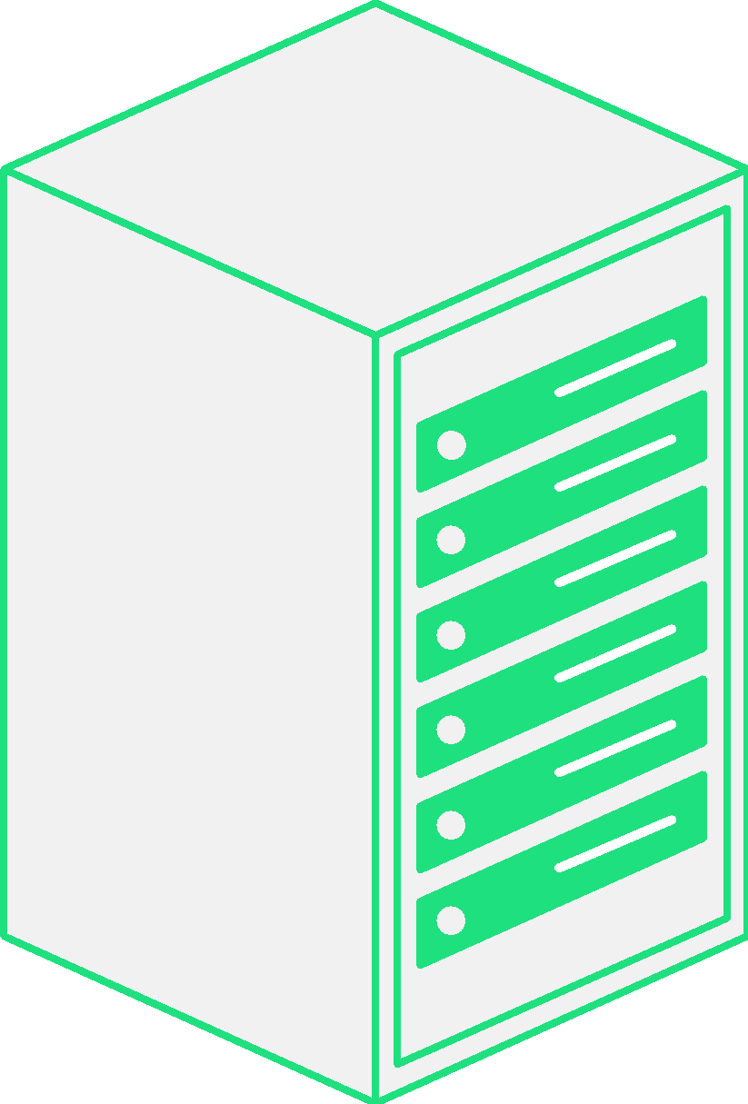
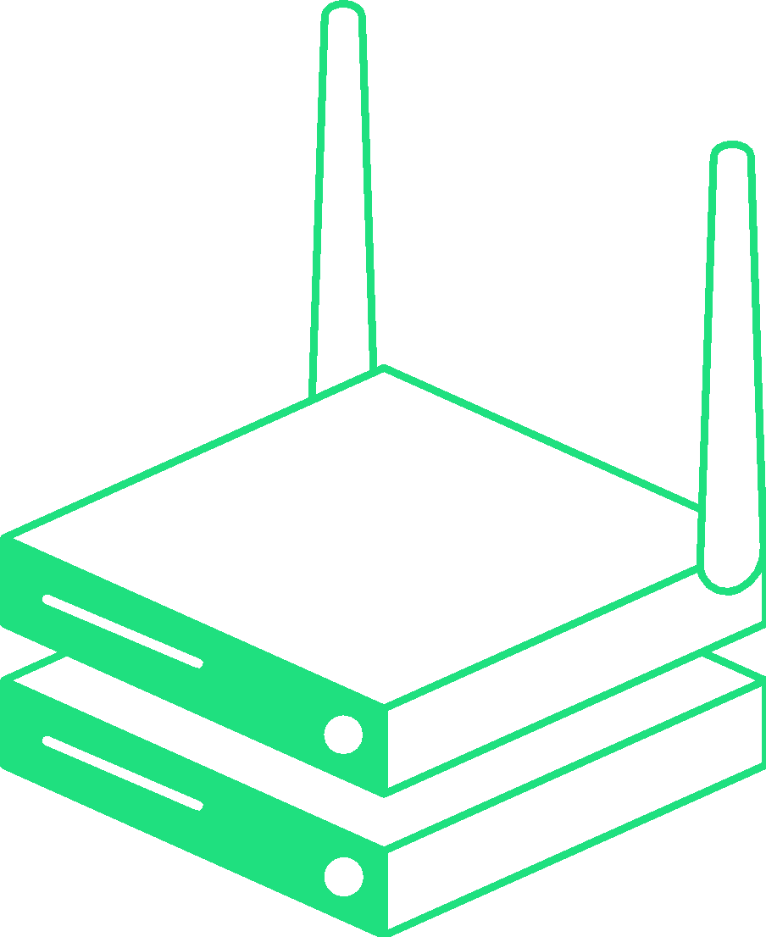
Sunlight is a new way to deliver edge applications
Cut costs by consolidating your in-location infrastructure into a single highly available stack
Speed time-to-market and cut support burden by standardising across your locations
Increase pace of innovation by making it easy to deploy and update new applications
+
BLUE
PRINT
L
App
+
BLUE
PRINT
M
App
BLUE
PRINT
S
+
App
$$$
$
85%
Reduction in infrastructure costs
70%
Reduction in time to bring up new edge systems
$0
Incremental costs to deploy a new application
$

Slide 9
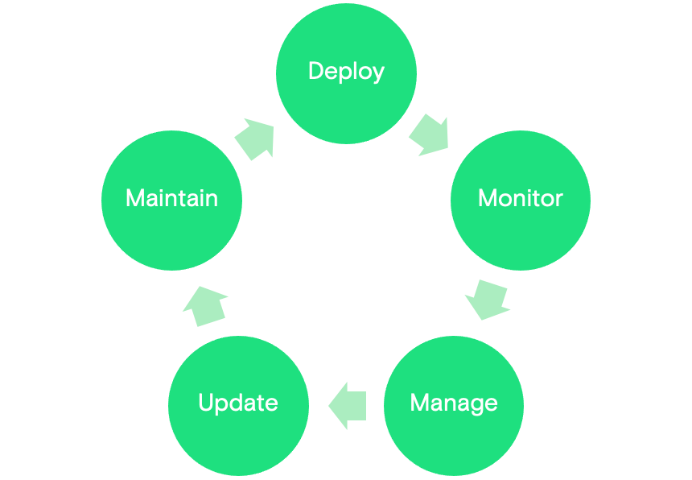
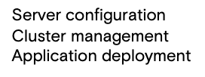
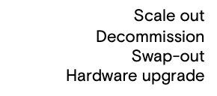


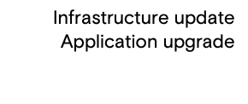
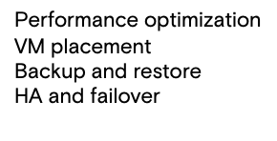
With application lifecycle management across all your locations
Remote locations
AppLibrary

Slide 10
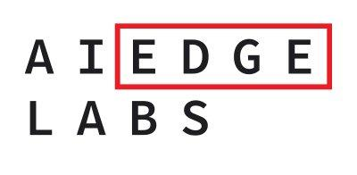

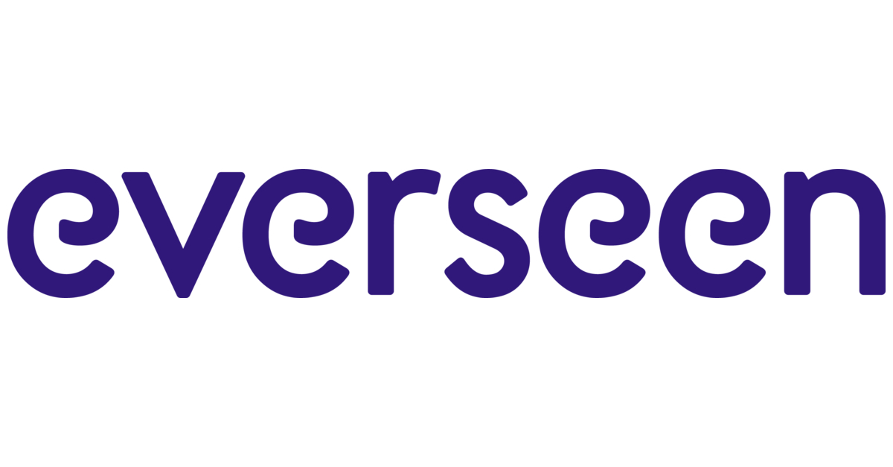


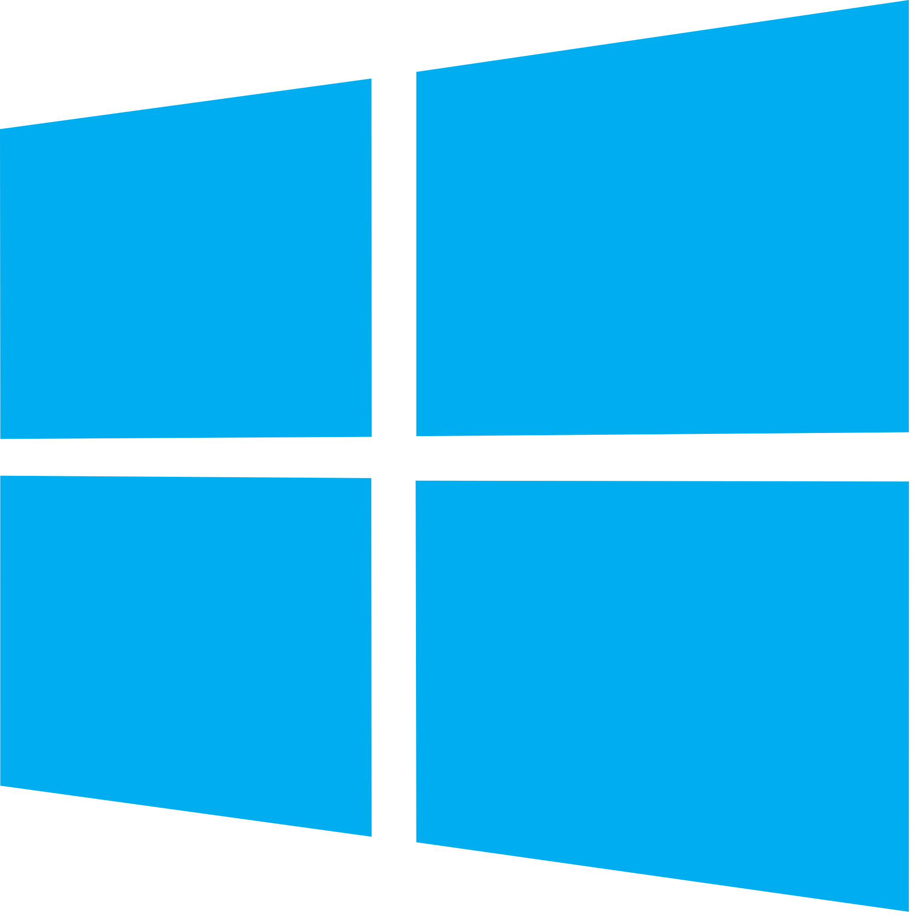

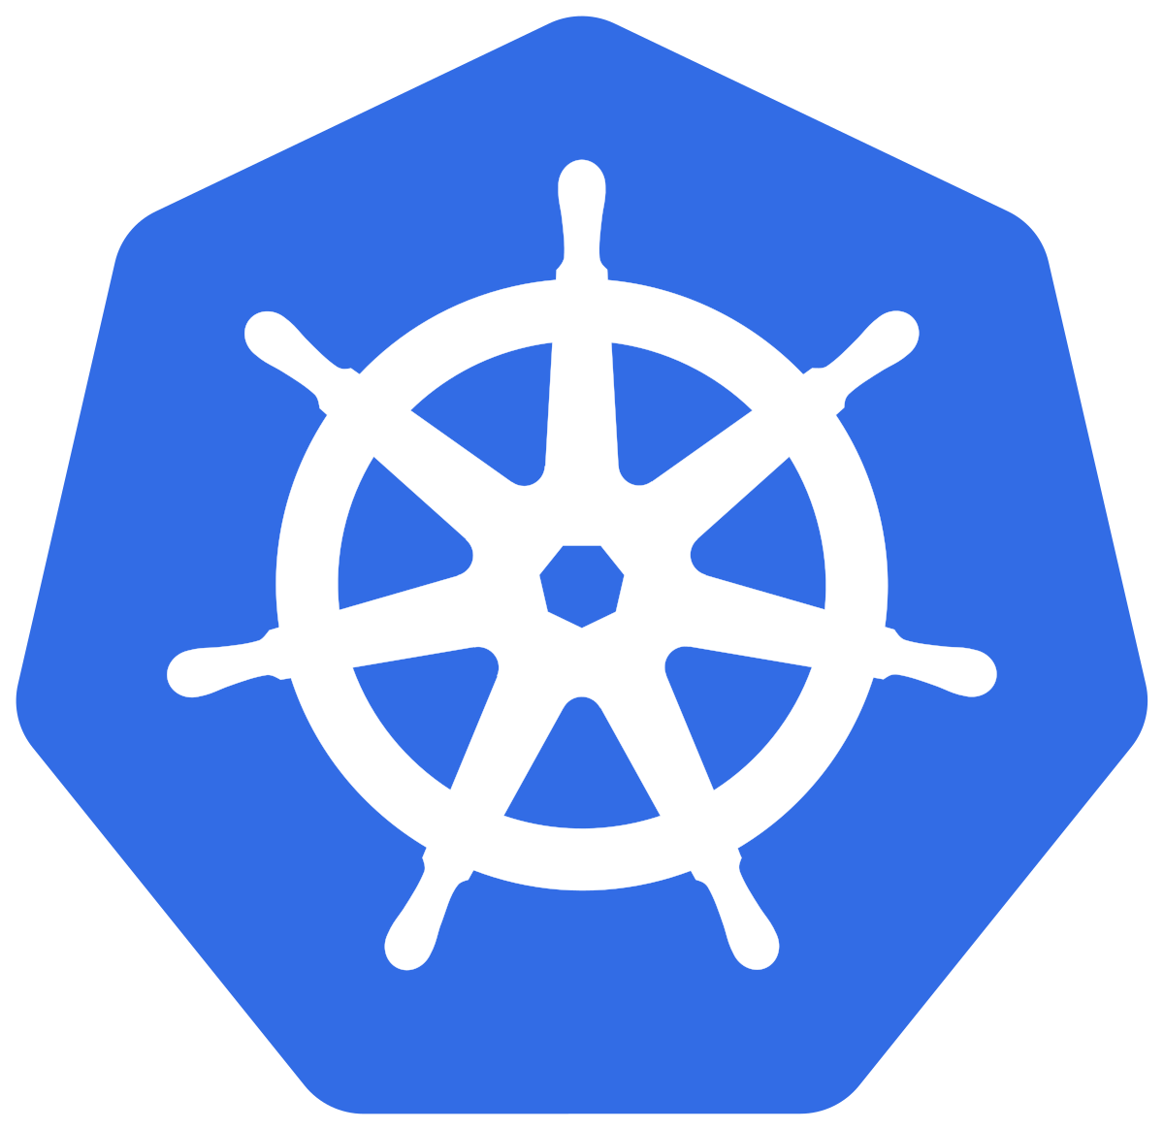
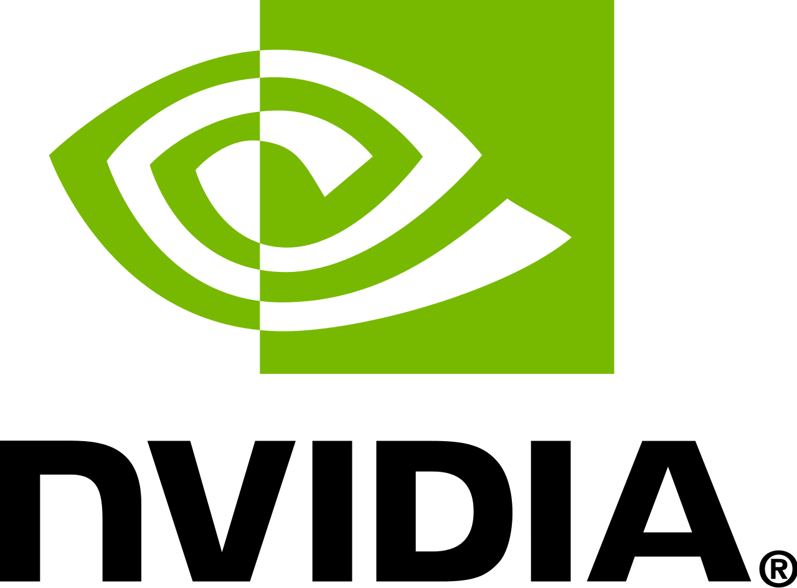
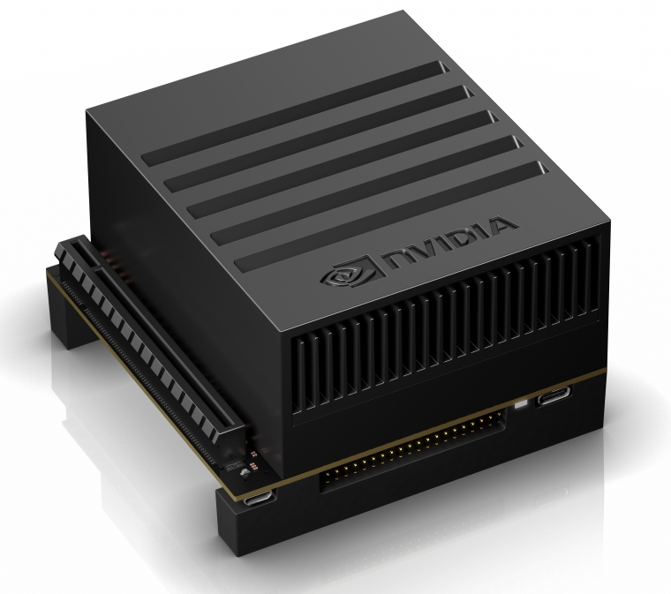
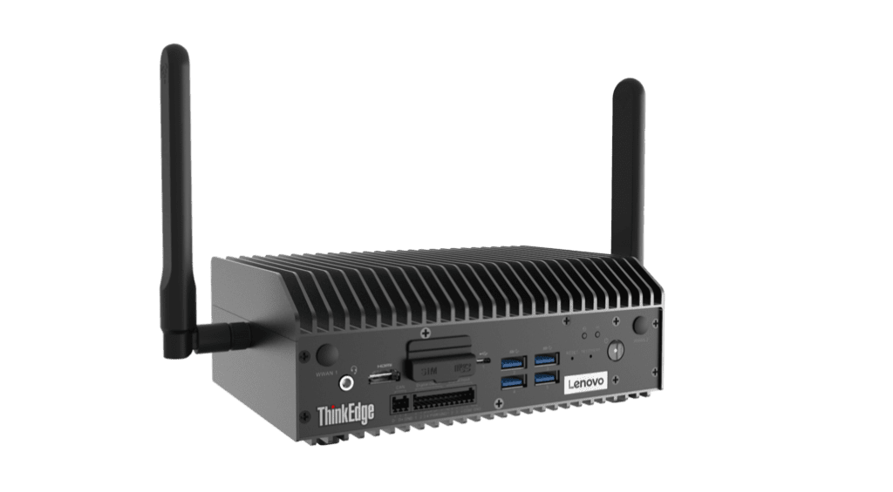
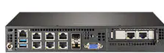
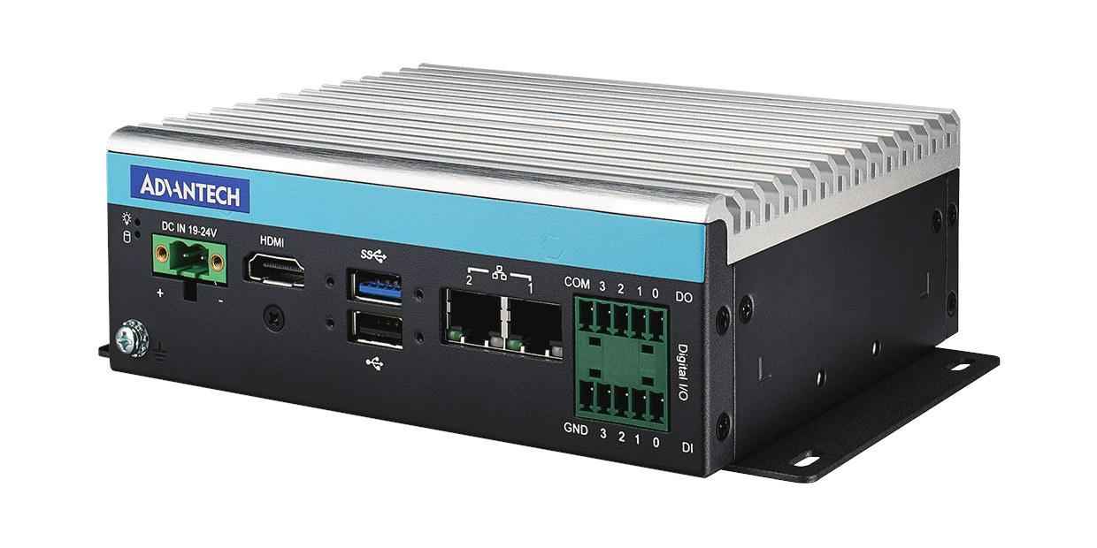



Works with the entire edge ecosystem
Any
application
Any app
architecture
One infrastructure platform
One centralised management dashboard
1000s distributed locations
Any CPU/GPU
Any
hardware

Slide 11
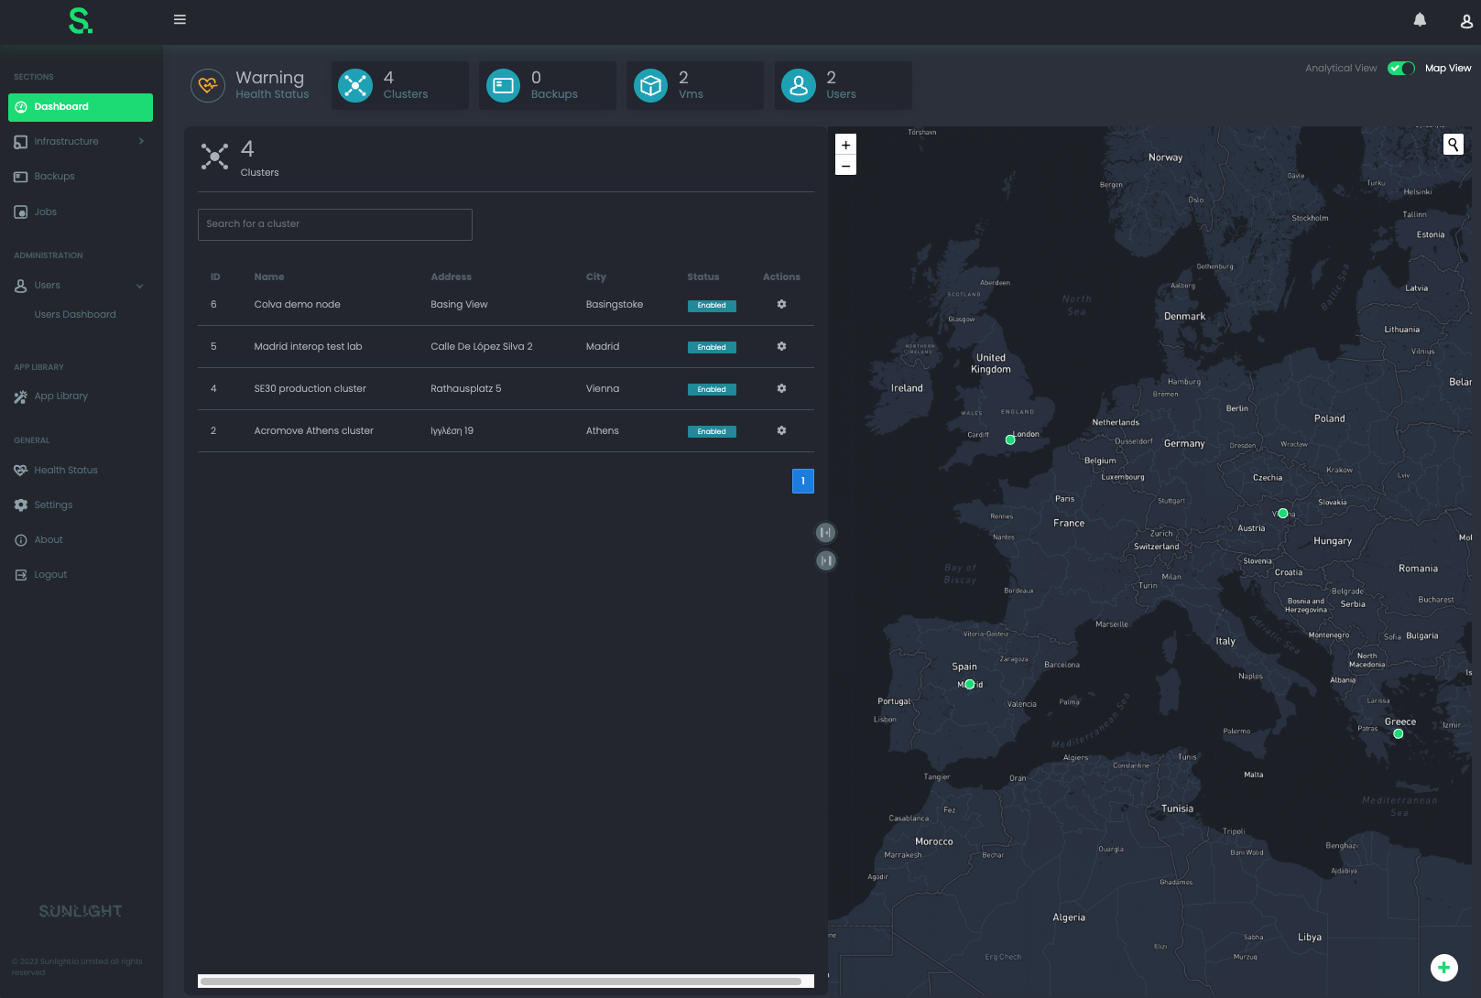
Centralized management of nodes - located anywhere in the world

Slide 12
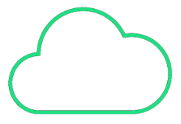







Easy to deploy your edge applications across 1000s of locations
Tiny physical footprint
Enterprise class availability
Centrally remotely manageable
One-click application deployment
Deliverable ‘as a service’
Notes:
The world is changing, advances in technology are changing all aspects of the way we live and where we create data. Applications such as Data Analytics, the Internet of Things, Artificial Intelligence, Machine Learning and Smart Cities are changing the world around us — whether its health and we’re mapping the human genome or in retail with self-service store check outs. We all know about remote working, working from home, maybe it’s agriculture, maintaining crop yields, or in industry monitoring remote oil rigs and creating factory automation. All of this is changing how we live and this is only accelerating.

Slide 13
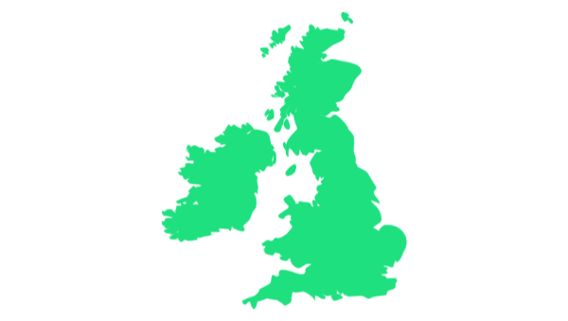
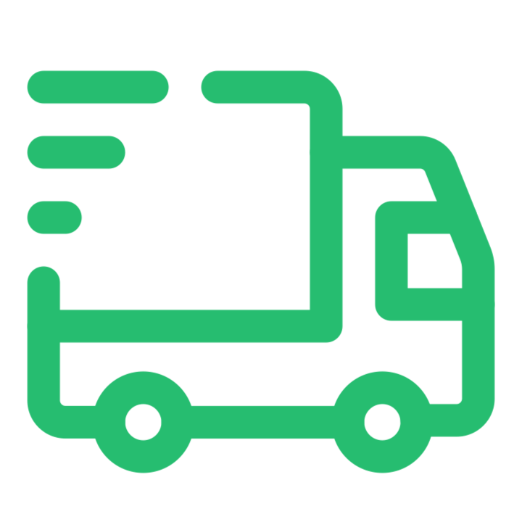
One way to deliver at scale is with Edge-as-a-Service
As an option, it is possible to deliver the complete hardware and software solution ‘as a service’ with Sunlight and Lenovo
Simple per node term-based licensing delivers a recurring revenue model
Subscribe and Pay-as-you-Grow
Hardware and software are delivered as a complete package to the remote site, ready to power-on and deploy apps
A Complete Edge Platform
Subscribe per node for a one-stop method of deploying applications at the edge.
Simple to Scale
Add additional nodes as requirements grow.
Services, Software and Hardware
Choose the size of node and subscribe for a complete solution stack.
Shift from Capex to Opex
Flexible finance that allows acceleration of transformation, coupled to a reduced cost of ownership and quick return on investment.

Slide 14

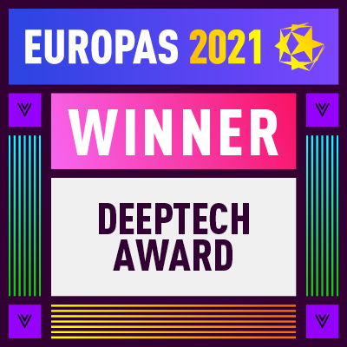
The best way to deploy applications in your edge locations
Simplicity
All your edge applications delivered ‘as a service’
Scale
Manage 1000s of locations from a single pane-of-glass
Cost
1/5 the total infrastructure cost of alternative solutions
Notes:
Why choose Sunlight?
Sunlight is deisgned edge-first – able to run in constrained and non-uniform environments, rather than as a repurposed core datacenter platform that expects uniformity, unlimited scale out, stringent power and cooling
Sunlight squeezes all the performance possible out of seemingly tiny hardware – opening up a whole range of new possibilities for deploying intelligent edge services
Sunlight loves microservices! They run way better and more securely on Sunlight!
And all of this is easy to test, deploy and manage – we can make it easy to get started on your edge computing strategy.

