Slide 1
Fast-tracking restaurant chain digital transformation with Sunlight & Lenovo
The consolidation of old and new technologies is on the menu
Quick-Service, or Fast-Food, restaurants are experiencing a surge in post-COVID innovation as customer buying behaviors are changed forever. Customers increasingly demand a better experience - personalization, touchless ordering, smart drive-thrus with pick-up times measured in seconds, and highly consistent food quality. This has all been exacerbated by on-going staff shortages and rising labor costs. These factors have put pressure on speed, throughput and accuracy.
The good news is that new AI-driven smart applications are appearing that can help deliver on these needs. The bad news is that all these new capabilities mean more IT systems that have to be installed and managed at each location. This leads to high infrastructure costs, more pressure on valuable floor-space, and increased reliance on expensive IT skills to keep things running.
What are their challenges?
Customers demand a faster, more personalized customer experience.
Inflation has led to rising labor, fuel & general costs.
Labor shortages make it harder to offer the fast and personalized experience customers demand.
Multi-channel ordering creates additional complexity as restaurants have to prioritize online orders against in-store orders.
Ensuring the health and Safety of staff and customers.
How are they solving these challenges?
Restaurant chains are deploying new application technologies in each of their restaurants to improve customer experience, reduce cost and automate processes.
These applications utilize the latest advances in AI, Machine Learning, IoT and Computer Vision and include numberplate recognition, drive-thru voice recognition, kitchen management systems, kitchen automation, restaurant management systems, robotics, smart signage, and smart kiosks.
Has the solution led to other challenges?
Rolling out new applications (alongside legacy applications) across 100s or 1000s of restaurants creates complexity.

Slide 2
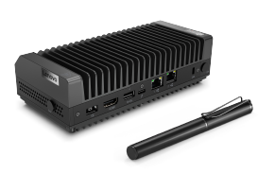
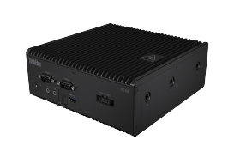
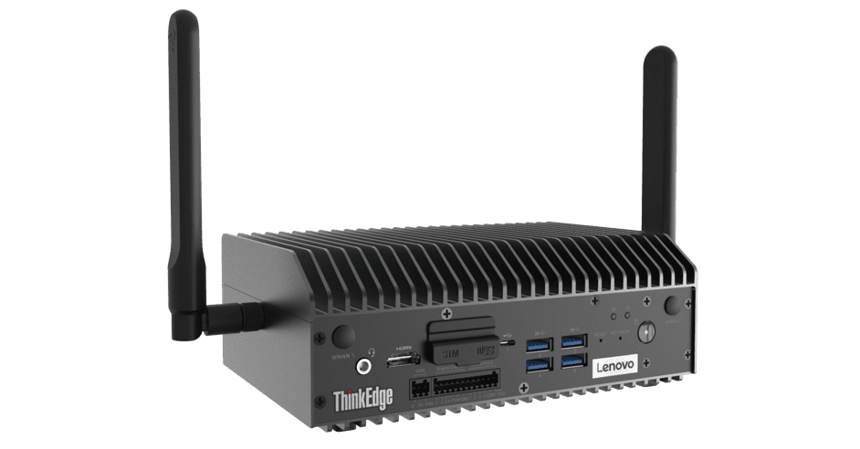
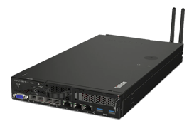
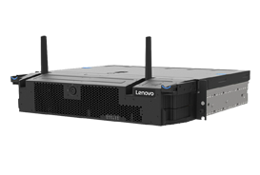
Each new application requires its own hardware and management system, leading to ‘tech sprawl’, underutilized hardware, and unnecessary overheads (e.g. power and space).
As restaurant chains become increasingly reliant on connected technology in restaurants, the cost of down time when WAN links fail also increases. The average cost of POS outages is $282,000 per hour (The Standish Group).
Restaurants don’t have dedicated IT personnel at each site. Truck rolls (when they need an engineer to travel to site each time a technology is deployed, needs upgrading or fails) are expensive.
How is Sunlight & Lenovo solving these challenges?
1. Consolidation of infrastructure
The Sunlight HyperConverged Edge is a full-stack, bare-metal virtualization platform that combines the computing, storage, and networking of one to multiple servers into a single system or cluster. Each cluster, deployed in a remote location, can consolidate multiple instances of Windows, Linux, or containers on x86, AMD, Arm, and NVIDIA Jetson and provides High Availability and Fault Tolerance.
2. Management
The Sunlight NexCenter is the centralized console and API that provides a single pane of glass to manage and monitor edge resources, take backups, move workloads, and deploy new remote clusters. A core feature of NexCenter is the AppLibrary which allows restaurant chains to build and access playbooks (images & recipes) for deploying applications and the supporting infrastructure to 100s or 1000s of remote clusters with a single click.
3. Lenovo ThinkEdge & ThinkSystem range
The Lenovo edge servers offer the power, performance and flexibility customers need to build next-level edge networks. Lenovo edge servers, coupled with Sunlight’s HyperConverged Edge stack and NexCenter, are ideal for data-intensive applications at the edge, such as IoT and AI, due to their small footprint and high performance possibilities.
Case study
A restaurant chain came to Sunlight and Lenovo with a challenge - they needed to add new applications to each of their 700 locations, while continuing to run existing applications with high availability. They already had several workloads running at each location and were wary of relying on the Cloud in case the WAN failed and operations stalled.
Sunlight and Lenovo are working with the brand to consolidate their restaurant infrastructure using the Sunlight HyperConverged Edge stack and Lenovo edge servers. This will allow them to run legacy and new applications (whether in VMs or containers) with high availability and fault tolerance.
The Sunlight NexCenter will allow them to centrally manage all of their locations from the central HQ – saving them time and money on management of each restaurant - with far fewer truck-rolls required when problems are reported.
70%
Faster time-to-market
SE30
SE50
SE70
SE350
SE450
75%
Reduction in TCO

