Slide 1
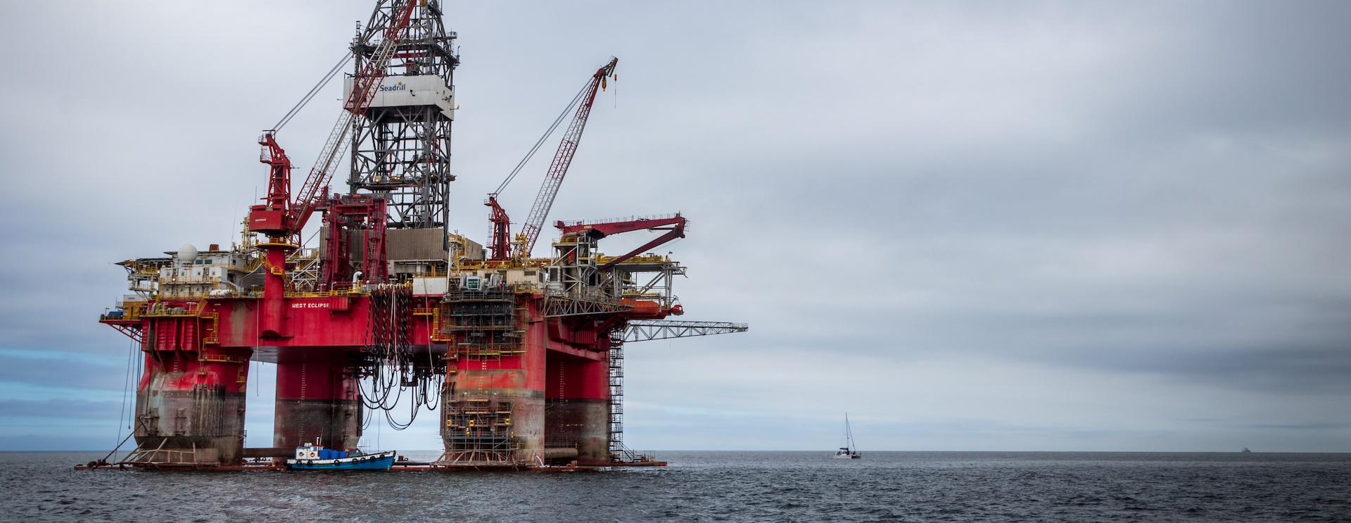
Groundbreaking oil & gas innovation with Sunlight & Lenovo
Extracting value in complex and harsh conditions
Oil and Gas companies are operating large, complex business assets (such as offshore rigs, refineries and pipelines) in often unpredictable geo-political and regulatory environments. At the same time, demand for more sustainable and cost-effective ways to extract, manage and use the world's resources means that the industry is innovating at a rapid rate.
Applications for predictive analytics and maintenance, surveillance, asset tracking, emissions testing, field management, employee safety, video analytics and machine learning are running across distributed environments that have traditionally been a reason for information delays, silos of information, and reactive operations. A single oil well can generate 10TB of data a day.
What are their challenges?
The cost of a day's downtime at sites like these can cost tens of millions of dollars.
Gathering, organizing and analyzing data from fragmented systems for insights and reporting is extremely challenging.
IT control is not standardized across the company.
It’s difficult to ensure cross-border data sovereignty for data control and security.
How are they solving these challenges?
Piecing together cloud and edge computing technologies from data center environments and attempting to make it work for their edge sites.
Migrating non-high-performance computing to public cloud environments to facilitate the centralization of data and integration of operating processes.
Has the solution led to other challenges?
Piecing together different unintegrated technologies can be highly complex and difficult to manage. It makes it difficult to standardize IT across sites. They need the ability to integrate from enterprise to asset for cost-efficiency, reliability and agility.
They are over-reliant on the public cloud. The migration of non-HPC to the public cloud doesn’t solve data sovereignty issues and can still be a problem when WAN links fail.
Hyperscale cloud services are not well-suited for highly distributed and remote environments.
Not all applications run in the cloud - some only run on-prem.
They lack IT personnel at each site to maintain, troubleshoot and ensure security of systems.

Slide 2
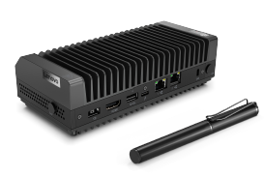
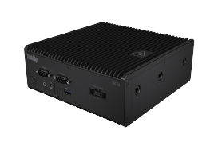
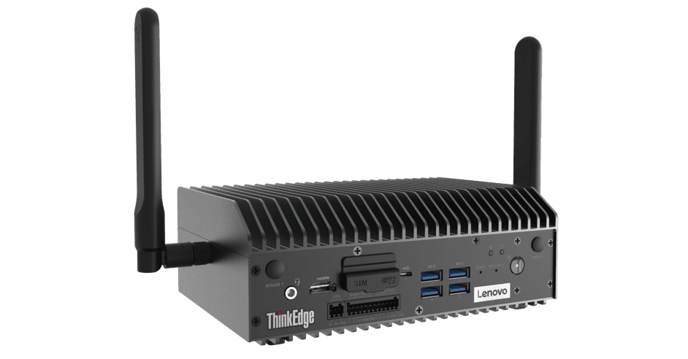
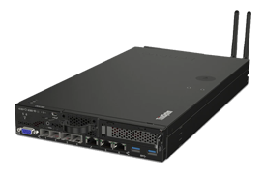
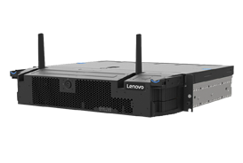
How is Sunlight & Lenovo solving these challenges?
Computing solutions need to span physical locations, functional boundaries and organizational borders while offering high availability, low latency, easy integration and data accessibility in distributed, remote and harsh environments. Multiple entities need to interact with each other both across these highly distributed sites and the core HQ: Edge-to-Core-to-Edge.
1. Reliable, ruggedized, small form-factor on-prem infrastructure
The Sunlight HyperConverged Edge is a full-stack, bare-metal virtualization platform that combines the computing, storage, and networking of one to multiple servers into a single system or cluster. Each cluster, deployed in a remote location, can consolidate multiple instances of Windows, Linux, or containers on x86, AMD, Arm, and NVIDIA Jetson and provides High Availability and Fault Tolerance.
2. Centralized management and automation
The Sunlight NexCenter is the centralized console and API that provides a single pane of glass to manage and monitor edge resources, take backups, move workloads, and deploy new remote clusters. A core feature of NexCenter is the AppLibrary which allows oil and gas companies to build and access playbooks (images & recipes) for deploying applications and the supporting infrastructure to 100s or 1000s of remote clusters with a single click.
The AppLibrary and NexCenter can support a range of applications - whether legacy VM-based, Kubernetes or container based.
3. Lenovo ThinkEdge & ThinkSystem range
The Lenovo edge servers offer the power, performance and flexibility customers need to build next-level edge networks. Lenovo edge servers, coupled with Sunlight’s HyperConverged Edge stack and NexCenter, are ideal for data-intensive applications at the edge, such as IoT and AI, due to their small footprint and high performance possibilities.
Case study
Sunlight is talking to a multinational energy corporation about the technology their data specialists use to provide support to those in the field. The data is used for:
Real-time monitoring: well performance, incident prevention, fault detection and remote drilling.
Trends: operational efficiencies and predictive modelling.
Over time, the corporation has added new technologies and systems (alongside their legacy systems) to extract and utilize data. This has become increasingly complex, unreliable and unmanageable. The Lenovo ThinkEdge and ThinkSystem range are sufficiently rugged and can withstand the harsh environments the technology needs to operate in. The Sunlight HyperConverged Edge infrastructure stack and NexCenter, running on the Lenovo edge servers, makes it easy to deploy, monitor and manage desired technologies across distributed sites, with centralized management, low latency, high availability and disaster recovery, from edge-to-core.
70%
Faster time-to-market
SE30
SE50
SE70
SE350
SE450
75%
Reduction in TCO

