Slide 1
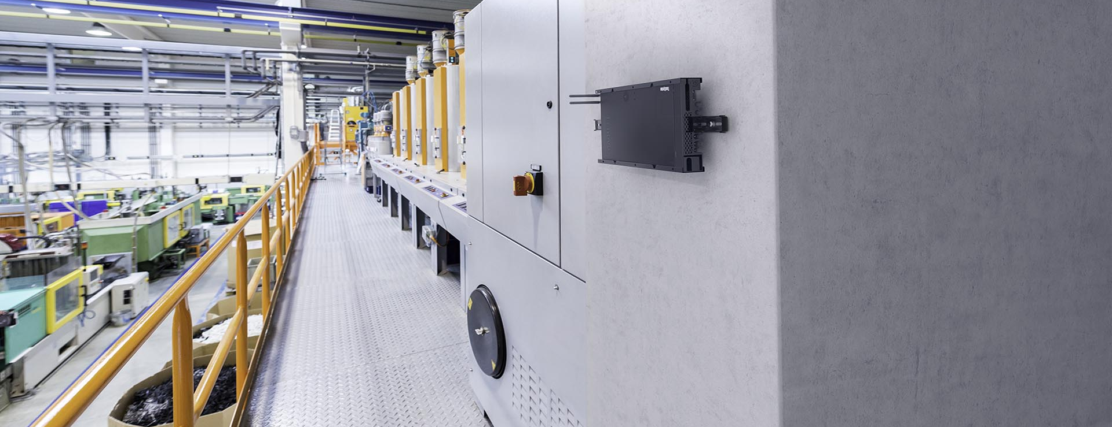
Building a lean infrastructure for smart manufacturing with Sunlight & Lenovo
Generating efficiencies in industrial environments
Fluctuations in demand, a lack of skilled workers, and supply chain instability are just some of the major challenges manufacturers are facing today. Manufacturers are having to become smarter to optimize efficiency of operations, reduce costs, improve product quality and scale as needed.
Manufacturing today is therefore moving to real-time monitoring and management with the help of IoT. IoT in the manufacturing market is projected to reach $1.5tn in 2030 (from $198bn in 2020).
Collecting and analyzing data from production lines enables faster and more reliable processes on the factory floor. Pushing these capabilities into the cloud doesn't work as it requires placing compute right next to the sensors, cameras and actuators to minimize latency and cope with the huge volumes of data.
What are their challenges?
Increase speed of production to improve yield.
Detect and reduce faulty products to reduce cost.
Ensure continuous production by reducing downtime of tools and machines.
Ensure the safety of staff and machinery.
How are they solving these challenges?
Industry 4.0 has accelerated technology adoption in factories. Manufacturers have turned to IoT, AI, ML and Computer Vision to address these issues.
Predictive maintenance: Continuous analysis of data from sensors enables early identification of maintenance requirements for reduced downtime.
Quality control: Applying real-time AI to production line video streams can identify quality issues in real-time, increasing yield and preventing waste.
Digital twin: To maximise availability and performance by monitoring and optimizing the production line.
SCADA systems: provide an accurate picture of the state of manufacturing systems.
Safety: Video analytics, AI, and environmental sensors for monitoring site and employee safety.
Has the solution led to other challenges?
The IoT technologies that are being used to solve manufacturing challenges are the cause of infrastructure complexity.
Gathering, organizing and analyzing data from fragmented systems for insights and reporting is extremely challenging.

Slide 2
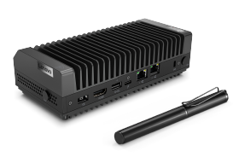
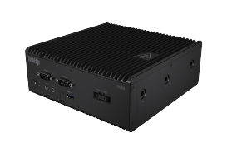
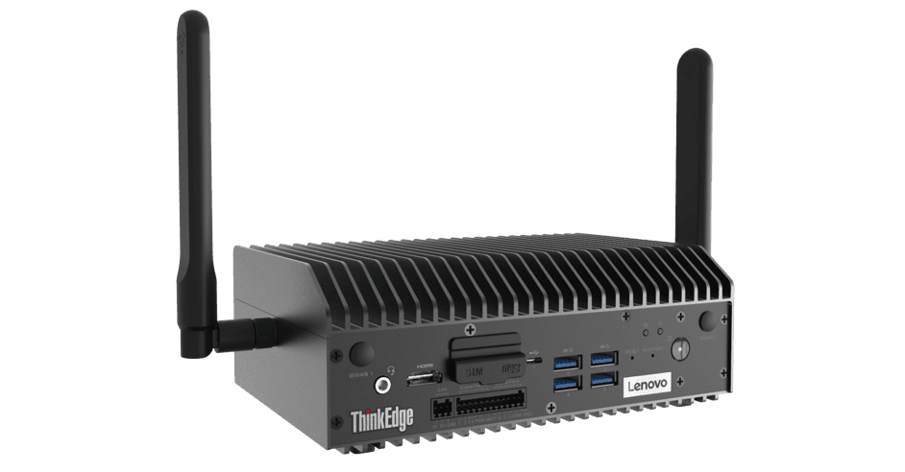
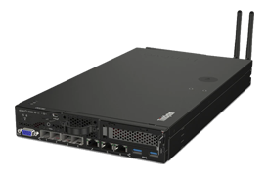
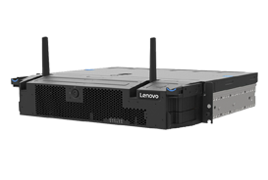
Each new application has it’s own infrastructure requirements – manufacturers are adding new servers for each new technology – leading to underutilized hardware and tech sprawl.
A lack of IT personnel at each site to maintain, troubleshoot and ensure security of systems.
Downtime can lead to significant disruption and losses.
Space is at a premium – space used for hardware is space taken from production.
How is Sunlight & Lenovo solving these challenges?
1. Reliable, ruggedized, small form-factor on-prem infrastructure
The Sunlight HyperConverged Edge is a full-stack, bare-metal virtualization platform that combines the computing, storage, and networking of one to multiple servers into a single system or cluster. Each cluster, deployed in a remote location, can consolidate multiple instances of Windows, Linux, or containers on x86, AMD, Arm, and NVIDIA Jetson and provides High Availability and Fault Tolerance.
2. Centralized management and automation
The Sunlight NexCenter is the centralized console and API that provides a single pane of glass to manage and monitor edge resources, take backups, move workloads, and deploy new remote clusters. A core feature of NexCenter is the AppLibrary which allows manufacturers to build and access playbooks (images & recipes) for deploying applications and the supporting infrastructure to 100s or 1000s of remote clusters with a single click.
The AppLibrary and NexCenter can support a range of applications - whether legacy VM-based, Kubernetes or container based.
3. Lenovo ThinkEdge & ThinkSystem range
The Lenovo edge servers offer the power, performance and flexibility customers need to build next-level edge networks. Lenovo edge servers, coupled with Sunlight’s HyperConverged Edge stack and NexCenter, are ideal for data-intensive applications at the edge, such as IoT and AI, due to their small footprint and high performance possibilities.
Case study
Sunlight is talking to a plastics manufacturing company that wants to implement analytics technology to gain insight into equipment run rates across their ten factories. The client doesn’t have IT personnel available at each site, so they are looking for a secure, edge-appropriate hardware and software solution that can be sent directly to the factories. They need a solution that can be plugged in and powered on by any member of staff, with centralized monitoring, management and high availability.
Sunlight’s Edge-as-a-Service solution with Lenovo and Avnet Integrated provides this. It makes it easy for the client’s VAR partner to order pre-configured edge infrastructure solutions, complete with Lenovo edge hardware, software, and centralized management, to any location directly from the digital storefront.
70%
Faster time-to-market
SE30
SE50
SE70
SE350
SE450
75%
Reduction in TCO

