Slide 1
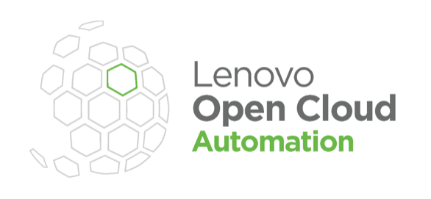
LOC-A and Sunlight:
A single pane of glass to manage the distributed edge
www.sunlight.io

Slide 2
What is LOC-A?
What is Sunlight?
LOC-A - The Lenovo Open Cloud Automation service is a control interface to install a system onto the hardware for remotely accessing the console, reinstalling machines, and power cycling.
Hardware inventory, Device discovery and OS installation
Ship a physical node anywhere and remotely install and manage it via the LOC-A console.
Supported on systems with XClarity out-of-band controller: SD530, SR630/650, VX630/650, SE350/450 Edge servers.
The Lenovo marketplace runs on Sunlight. Sunlight is the only HyperConverged stack built for Lenovo Edge Hardware:
Fault-tolerant Micro-cluster deployed at the edge.
Deploy and manage Edge applications across 1000s of sites from a centralized dashboard.
Supports the full Lenovo edge portfolio: ThinkEdge and ThinkSystem servers (SE10, SE30, SE50, SE70, SE350, SE450) and Datacenter servers (SR630/650). Supports X86, Arm, AMD and NVIDIA Jetson.
Sunlight installs onto the baremetal hardware via LOC-A.
Hardware Inventory Track inventory of assets
Device Discovery Remote identification of nodes
Remote Workload Imaging
Install multi-tenant hypervisor or container host

Slide 3
Manage the distributed edge with Sunlight and LOC-A
Sunlight HyperConverged Edge can be installed as an image on LOC-A compatible systems.
Sunlight and LOC-A benefits include:
Out-of-band management (via XClarity) for hardware control and installations.
In-band management (via Sunlight) for applications and workloads that run on the edge hardware.
Sunlight brings full application lifecycle management to LOC-A deployments, such as:
Computer Vision workloads.
AI/ML Execution at the edge.
Factory Automation.
Retail store tech transformation.
1-Click application deployment.
Centralised control of High Availability and application failover for any edge location.
Distributed Edge disaster recovery and instant restore of services.
+

Slide 4
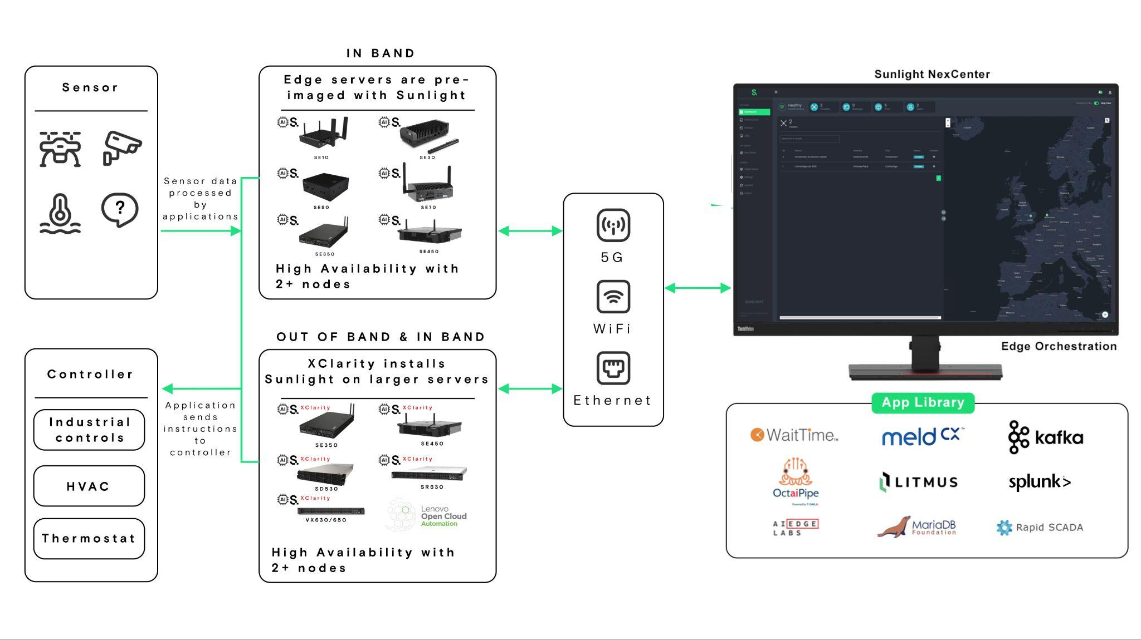
How does Sunlight fit with LOC-A?
Sunlight provides a single solution that complements LOC-A to manage all Lenovo servers (with and without the XClarity controller) from a single pane of glass.

Slide 5
Thank you
www.sunlight.io
www.lenovo.com

