Slide 1
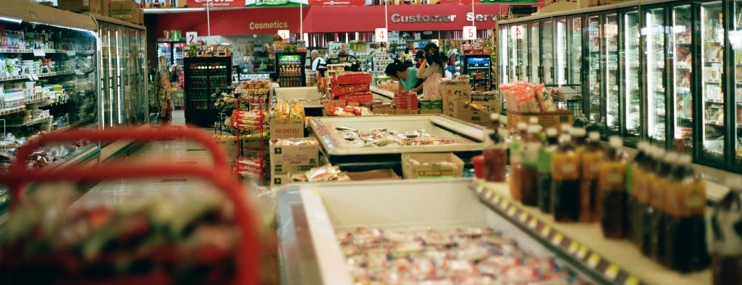
Checking out grocery store digital transformation with Sunlight & Lenovo
A new recipe for grocery stores
Grocery retailers have had to adapt quickly to changes in the global macro and socio-economic environment that consistently continues to change and influence consumer behavior since the start of the COVID-19 pandemic and war in Ukraine. Retailers are dealing with supply shortages, higher costs, polarized purchasing power and changes to shopping preferences.
“Investments in technology used to feel optional for grocers—an opportunity to experiment or increase the “wow factor” in stores rather than to support mission-critical operations. Today, a wide range of affordable, field-tested technologies can help retailers reduce the cost structure of their stores while delivering a better experience for both consumers and employees. Audacious investments should be the next step for the industry.”
McKinsey (2022)
What are their challenges?
Post-pandemic demand for e-commerce remains high - but also with higher associated cost.
Inflation: labor, fuel & general costs have / continue to increase.
Supply and labor shortages - volumes are lower as we come out of COVID and stock outs mean there’s less product to sell.
Polarization of the consumer: lower-priced private label vs. sustainable / healthy / premium quality products.
This has all led to increased pressure on margins.
How are they solving these challenges?
Retailers are investing in in-store technology that can improve customer experiences and reset cost structures.
“According to our analysis, advanced tech enabled checkout, talent management, merchandising and replenishment, and store environment maintenance can help the grocery industry create distinctive in-store experiences for customers and reduce costs by as much as 15 to 30 percent.”
McKinsey (2022)
Has the solution led to other challenges?
Adding new technologies alongside existing technologies across highly distributed retail stores creates cost and complexity. This presents five primary challenges:
Distributed environments can be difficult and expensive to manage if engineers need to travel to site each time a new technology is deployed, upgraded or fails.

Slide 2
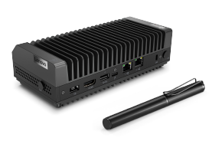
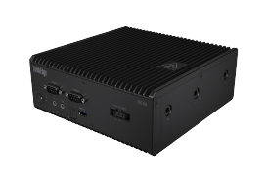
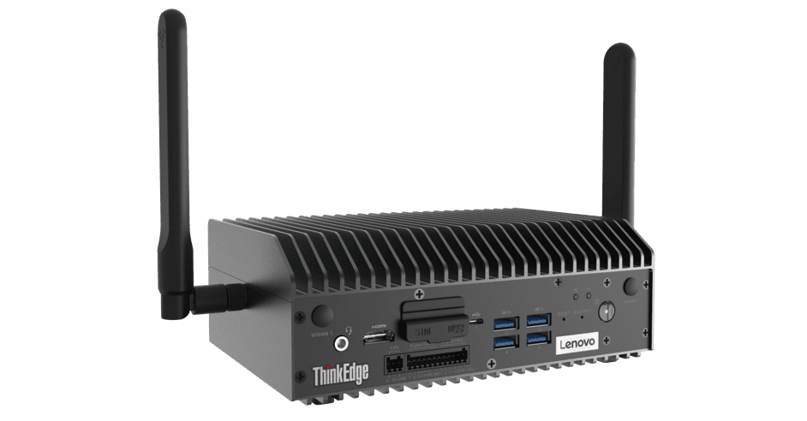
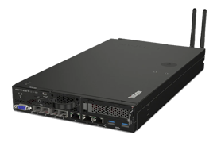
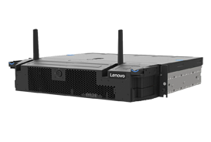
Scale: the solution works well in one or two sites - but is expensive and difficult to manage across 100s or 1000s.
Getting processing of data closer to the source for immediate insight to action.
Adding new infrastructure for each new technology can lead to sprawl, underutilized hardware and unnecessary overheads (e.g. power usage)
Down Time - As grocery retailers become increasingly reliant on connected technology in stores, the cost of down time when WAN Links fail also increases. To give an example, The average cost of POS outages is $282,000 per hour (Source: The Standish Group)
How is Sunlight & Lenovo solving these challenges?
1. Consolidation of infrastructure
The Sunlight HyperConverged Edge is a full-stack, bare-metal virtualization platform that combines the computing, storage, and networking of one to multiple servers into a single system or cluster. Each cluster, deployed in a remote location, can consolidate multiple instances of Windows, Linux, or containers on x86, AMD, Arm, and NVIDIA Jetson and provides High Availability and Fault Tolerance.
2. Management
The Sunlight NexCenter is the centralized console and API that provides a single pane of glass to manage and monitor edge resources, take backups, move workloads, and deploy new remote clusters. A core feature of NexCenter is the AppLibrary which allows retailers to build and access playbooks (images & recipes) for deploying applications and the supporting infrastructure to 100s or 1000s of remote clusters with a single click.
3. Lenovo ThinkEdge & ThinkSystem range
The Lenovo edge servers offer the power, performance and flexibility customers need to build next-level edge networks. Lenovo edge servers, coupled with Sunlight’s HyperConverged Edge stack and NexCenter, are ideal for data-intensive applications at the edge, such as IoT and AI, due to their small footprint and high performance possibilities.
Case study
Large grocery retailers, like a supermarket chain that Sunlight and Lenovo are talking to, need to run 1000s of refrigeration units, lights, and check-out tills. The operating cost for these is under rising pressure.
An advanced application solution that the supermarket chain is considering uses automation and analytics to allow the supermarket to manage the power supply to freezers. The solution uses sensors to assess the temperature state and time of day. Early studies suggest that the technology could make energy savings of up to 30% in each store. This equates to a saving of millions of dollars across the chain.
For the application solution to be successful, it needs to run in a highly distributed fashion and utilize data in real time. It needs compute processing power next to the data source – one that doesn’t require lots of power to run - and can be managed from a centralized location. That’s where Sunlight and Lenovo are uniquely positioned to help.
70%
Faster time-to-market
SE30
SE50
SE70
SE350
SE450
75%
Reduction in TCO

