Slide 1
Digital transformation that’s in a class of its own with Sunlight & Lenovo
It’s back to school for tech
The Covid-19 pandemic accelerated the adoption of technology in education - with lockdowns forcing all stages and types of learning to take place online. This led to a plethora of new technologies entering the classroom - or virtual classroom (EdTech). Forbes (2022) forecast the EdTech sector will grow to $680 million by 2027.
We are increasingly seeing a plethora of new apps entering the education setting - using AI and self-learning algorithms for automating repetitive tasks like grading papers, personalizing the learning experience, classroom management or implementing on-site security measures using Computer Vision. These new apps need to be deployed alongside existing software, such as Microsoft Office and ERP software for resource planning. Some of these technologies naturally sit in the cloud, whereas others have on-prem requirements.
What are their challenges?
Space constraints: Schools are often in older buildings and every bit of space is at a premium. There’s no space for stacks of hardware or a data center rack.
Lack of funding: Running everything in the cloud can be costly - especially for large amounts of data processing and storage. As more technologies are adopted by the education sector - this only becomes more costly and complex.
Termly ICT demands: School system administrators are hugely busy at the beginning/end of each term updating laptops/passwords etc.
Aging infrastructure: All hardware has a natural end of life. Many schools are now at a point where their hardware has come to its natural end of life. Replacing hardware is a considerable cost at a time when bills are also going up.
Security: It’s the school / educational institution’s responsibility to ensure the safety of their pupils by keeping track of who is coming and going - while maintaining data privacy.
Cloud reliance: If WAN links go down then learning stops. Cloud can also be costly and can lead to data privacy issues - especially where security systems are processing personal data.
How can they solve these challenges?
Space constraints: Putting in modern, reliable, ruggedized, small form factor equipment that can fit anywhere could give back space for something of immense value for them.
Reducing cost: Having a hybrid solution that allows data-intensive applications to run locally with centralized management reduces costs and downtime and makes infrastructure and application life-cycles easier to manage.

Slide 2
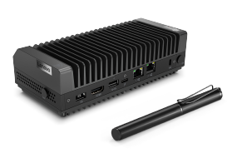
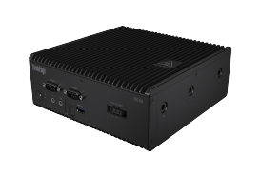
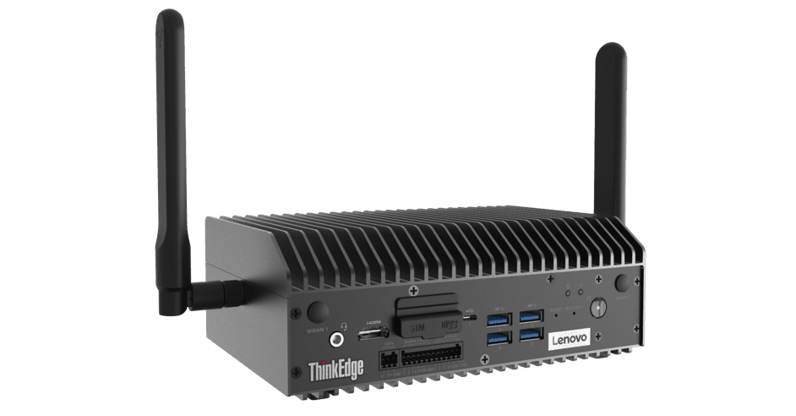
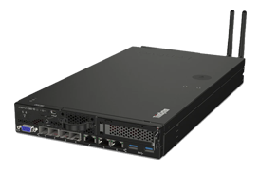
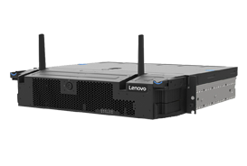
Termly ICT demands: Their infrastructure needs to be robust and reliable. It needs to take care of itself. When times are busy, it needs to just work.
Aging infrastructure: they need to consider what’s the best, lowest cost options that will provide flexibility now and for the next 3-5 years so they’re not having to add more hardware and software each time they want to introduce a new piece of learning technology.
Security: There are many new technologies that can make schools more secure - e.g. biometric entry (fingerprint in and out) or computer vision to identify if a child leaves the premises or an unusual person tries to enter. These new apps use AI to maintain appropriate health, safety and security while still respecting anonymity / GDPR / privacy rights of individuals.
How is Sunlight & Lenovo solving these challenges?
1. Reliable, ruggedized, small form-factor on-prem infrastructure
The Sunlight HyperConverged Edge is a full-stack, bare-metal virtualization platform that combines the computing, storage, and networking of one to multiple servers into a single system or cluster. Each cluster, deployed in a remote location, can consolidate multiple instances of Windows, Linux, or containers on x86, AMD, Arm, and NVIDIA Jetson and provides High Availability and Fault Tolerance.
2. Centralized management and automation
The Sunlight NexCenter is the centralized console and API that provides a single pane of glass to manage and monitor edge resources, take backups, move workloads, and deploy new remote clusters. A core
feature of NexCenter is the AppLibrary which allows school districts and networks to build and access playbooks (images & recipes) for deploying applications and the supporting infrastructure to 100s or 1000s of remote clusters with a single click. This can be provided fully managed as a service from your favorite MSP.
3. Lenovo ThinkEdge & ThinkSystem range
The Lenovo edge servers offer the power, performance and flexibility customers need to build next-level edge networks. Lenovo edge servers, coupled with Sunlight’s HyperConverged Edge stack and NexCenter, are ideal for data-intensive applications at the edge, such as IoT and AI, due to their small footprint and high performance possibilities.
Case study
Sunlight and Lenovo are working with Atom IT in the UK to solve these challenges for the schools they manage - these are mostly for ROBO hardware/software refreshes.
70%
Faster time-to-market
SE30
SE50
SE70
SE350
SE450
75%
Reduction in TCO

